Slide 1
GRAPHS

Slide 2
Graphs
“Graphs” are the mathematical and computer science abstraction that capture many shared and common concepts of real-life objects such as
networks, e.g.
water
electricity
internet
mazes
road maps

Slide 3
Terminology of Graphs
Graph consists of a set V of nodes, and a set E of edges
Node
has a unique label for identification
Edge
connects two nodes
any two nodes have at most one edge between them
can be a
“directed edge”: e.g. “from A to B” – a “one-way street”
“undirected edge”: e.g. “between A and B” – a “standard street”

Slide 4
Graph Example
B
A
F
D
C
E
G
This is not a map!
The positions of the nodes do not matter, only their interconnections
E.g. DELHI METRO “Map” gives interconnections, but not true locations

Slide 5
FIND THE DIFFERENCE
B
F
G
A
F
D
D
C
E
C
E
G
A
B

Slide 6
FIND THE DIFFERENCE
B
F
G
A
F
D
D
C
E
C
E
G
A
B
Crossing of edges has no meaning
A-D and B-E cross in the picture but they do not interconnect
These two pictures are the same graph

Slide 7
Terminology of Graphs
B
F
A
D
C
E
G
Path
Connected sequence of edges. For e.g. A->B->F->C->G
Usually not allowed to use the same node (or edge) twice
If the edges are directed then the path has to follow the directions of the edges. E.g. follow the one-way streets on a map

Slide 8
SIZE OF GRAPH
1
3
2
Graph G = (V,E)
n = | V | = # vertices
m = | E | = # edges
size of G is n + m
4

Slide 9
Graph Representation in a Program

Slide 10
1. Adjacency List
Adj(v) = list of vertices adjacent to v
space cost O(n+m)
1
1
2
3
3
2
1
3
2
3
1
2
4
4
4
3

Slide 11
2. Adjacency Matrix
A (i,j) = 1 , (i,j) ⋲ E
0 , otherwise
1
3
1 2 3 4
2
1
2
3
4
0 | 1 | 1 | 0
1 | 0 | 1 | 0
1 | 1 | 0 | 1
0 | 0 | 1 | 1
4

Slide 12
“Reachable”
Node B is said to be “reachable” from node A
if and only if
there is a path from A to B
Relevance to real-world:
Many search problems are questions about whether or not some “goal” is reachable from some “start” node.
Part of maintaining the internet topology is ensuring that any node (site) is reachable from any other site

Slide 13
Connected Graphs
Definition:
For any two nodes there is a path between them
That is any node is reachable from any other node
B
A
F
D
C
E
G

Slide 14
Example of Disconnected
B
A
F
D
C
E
G
There is no path from A to B

Slide 15
Cycles
Definition:
A cycle is a path that goes in a loop from a node back to itself, and without using the same node twice
For e.g. A-B-E-A
B
A
F
D
C
E
G

Slide 16
Tree
A tree is a graph
that is connected
but becomes disconnected if you remove any edge (“cut the edge”)
Matches “nature”
real trees are connected
cut any branch then the tree falls into two pieces
B
F
A
D
I
C
H
E
G
J

Slide 17
Depth First Search

Slide 18
A
B
C
D
E
F
G
H
I
J
K
L
M
N
O
P
Q
Goal nodes

Slide 19
A
B
C
D
E
F
G
H
I
J
K
L
M
N
O
P
Q

Slide 20
A
B
C
D
E
F
G
H
I
J
K
L
M
N
O
P
Q

Slide 21
A
B
C
D
E
F
G
H
I
J
K
L
M
N
O
P
Q

Slide 22
A
B
C
Backtracking!
D
E
F
G
H
I
J
K
L
M
N
O
P
Q

Slide 23
A
B
C
D
E
F
G
H
I
J
K
L
M
N
O
P
Q

Slide 24
A
B
C
D
E
F
G
H
I
J
K
L
M
N
O
P
Q

Slide 25
A
B
C
D
E
F
G
H
I
J
K
L
M
N
O
P
Q

Slide 26
A
B
C
D
E
F
G
GOAL !!!
H
I
J
K
L
M
N
O
P
Q

Slide 27
A
B
C
D
E
F
G
GOAL !!!
H
I
J
K
L
M
N
O
P
Q

Slide 28
Breadth First Search

Slide 29
A
B
C
D
E
F
G
H
I
J
K
L
M
N
O
P
Q
Goal nodes

Slide 30
A
B
C
D
E
F
G
H
I
J
K
L
M
N
O
P
Q

Slide 31
A
B
C
D
E
F
G
H
I
J
K
L
M
N
O
P
Q

Slide 32
A
B
C
D
E
F
G
H
I
J
K
L
M
N
O
P
Q

Slide 33
A
B
C
D
E
F
G
H
I
J
K
L
M
N
O
P
Q

Slide 34
A
B
C
D
E
F
G
H
I
J
K
L
M
N
O
P
Q

Slide 35
A
B
C
D
E
F
G
H
I
J
K
L
M
N
O
P
Q

Slide 36
A
B
C
D
E
F
G
H
I
J
K
L
M
N
O
P
Q

Slide 37
A
B
C
D
E
F
G
H
I
J
K
L
M
N
O
P
Q

Slide 38
A
B
C
GOAL !!!
D
E
F
G
H
I
J
K
L
M
N
O
P
Q

Slide 39
A
B
C
GOAL !!!
D
E
F
G
H
I
J
K
L
M
N
O
P
Q

Slide 40
FIND ALL THE WORDS WHICH CAN BE MADE FROM THE MATRIX AND ARE PRESENT IN DICTIONARY
DICTIONARY
I | R | S | T | G | E
F | D | H | P | K | L
W | H | E | L | G | D
E | S | W | F | L | C
R | Y | E | O | R | H
T | F | Q | A | L | G
HELLO
WORLD
DEPTH
FIRST
SEARCH

Slide 41
int dir[][] { {-1,-1},{0,-1},{1,-1},{1,0},{1,1},{0,1},{-1,1},{-1,0}} ;
int visited [][] ;
void words (char arr[][], int i , int j, char[] str)
{
visited [i][j] = 1 ;
int len = len(str) ;
str[len] = arr[i][j] ;
str[len+1] = ‘\0’ ;
if (isWord(str) )
cout << str ;
for (int k = 0 ; k < 8 ; k ++ )
{
if (( (i+dir[k][1])< n && i+dir[k][1]) >=0 && j+dir[k][0] <m && j+dir[k][0] >= 0 ) &&visited[i+dir[k][1]][ j+dir[k][0]]==0)
{
words(arr, i+dir[k][0], j+dir[k][1],str ) ;
}
}
visited [i][j] = 0 ;
str[len] = ‘\0’ ;
}
void printwords ( char arr[100][] )
{
for ( int i = 0 ; i < n ; i ++ )
for ( int j =0 ; j < m; j ++ )
{
char str[m*n] ;
str[0] = ‘\0’;
words ( arr, i,j, str) ;
}
}

Slide 42
DIJKSTRA’S ALGORITHM

Slide 43
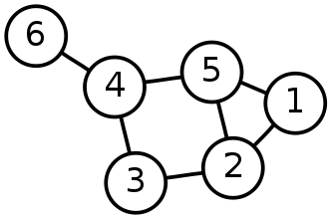
Single-Source Shortest Path Problem - The problem of finding shortest paths from a source vertex v to all other vertices in the graph.

Slide 44
Dijkstra's algorithm
It is a solution to the single-source shortest path problem in graph theory.
Works on both directed and undirected graphs. However, all edges must have nonnegative weights.
Approach: Greedy
Input: Weighted graph G={E,V} and source vertex v∈V, such that all edge weights are nonnegative
Output: Lengths of shortest paths (or the shortest paths themselves) from a given source vertex v∈V to all other vertices

Slide 45
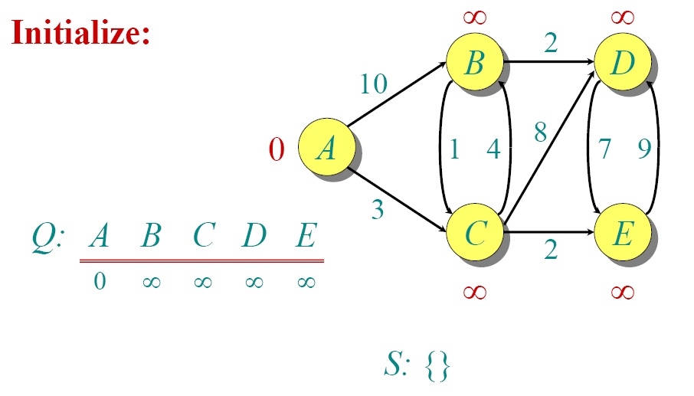
Example :

Slide 46
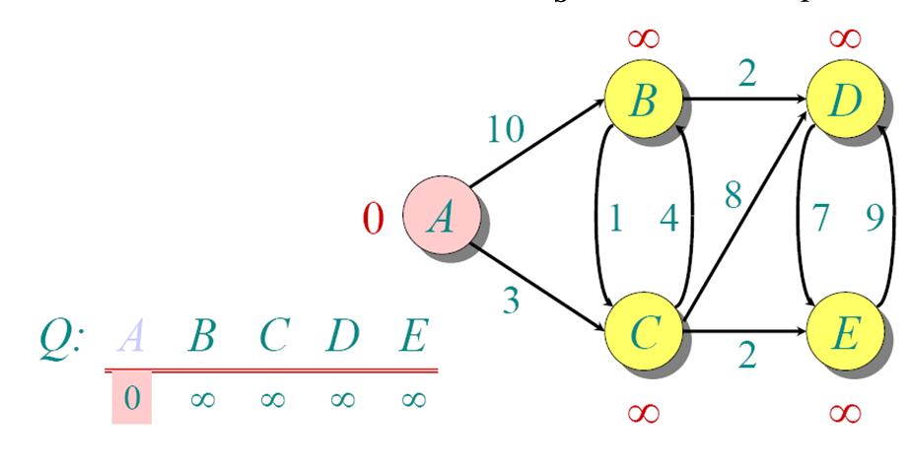

Slide 47
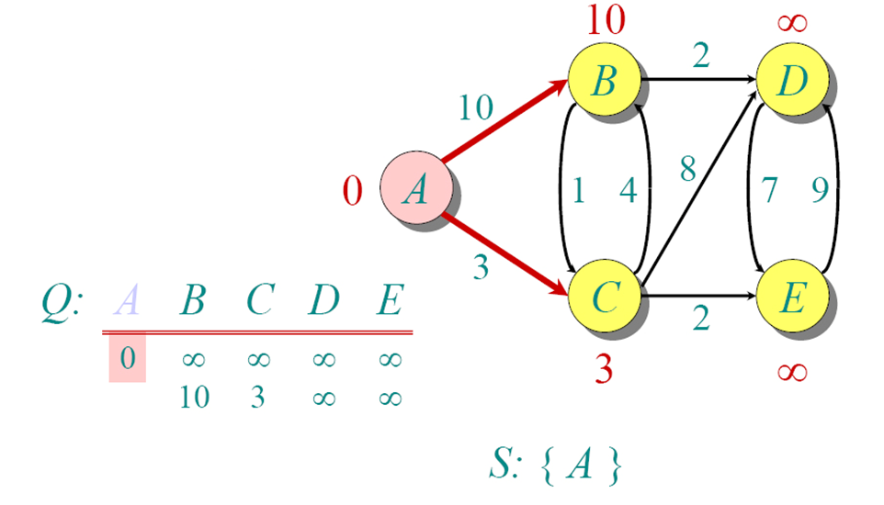

Slide 48
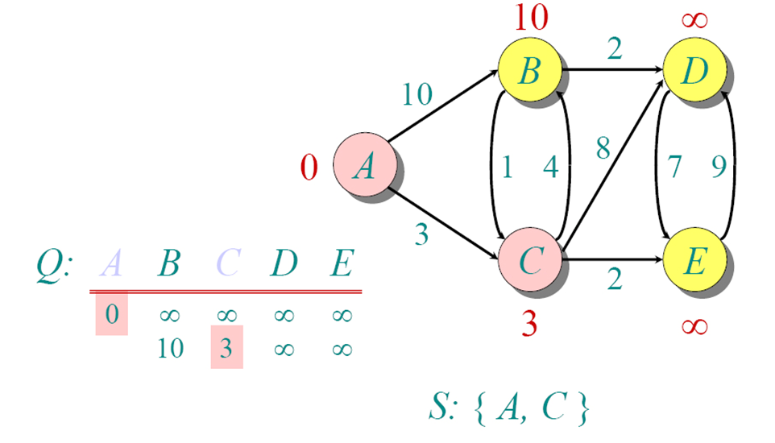

Slide 49
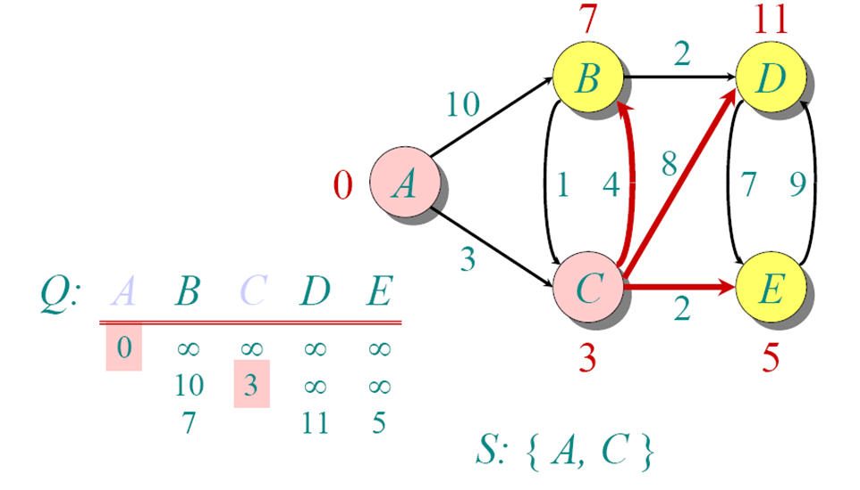

Slide 50
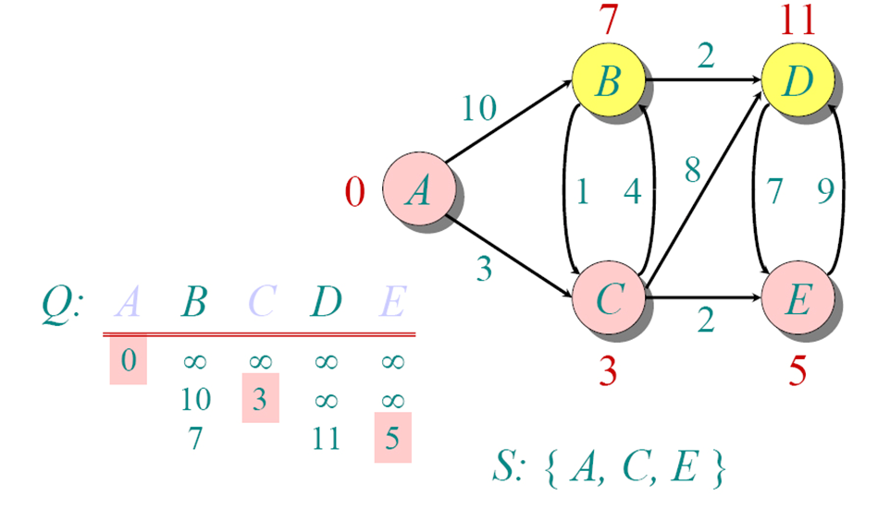

Slide 51
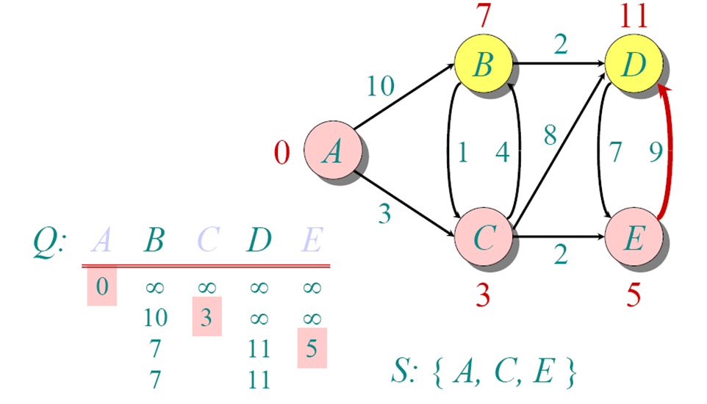

Slide 52
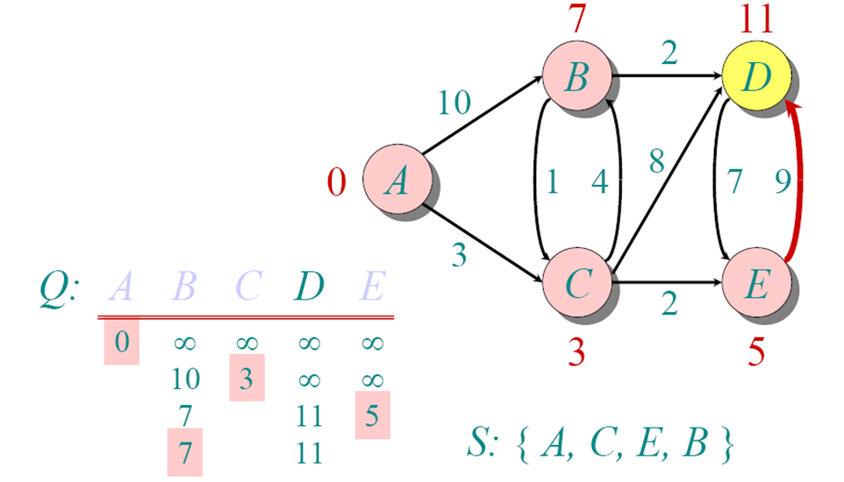

Slide 53
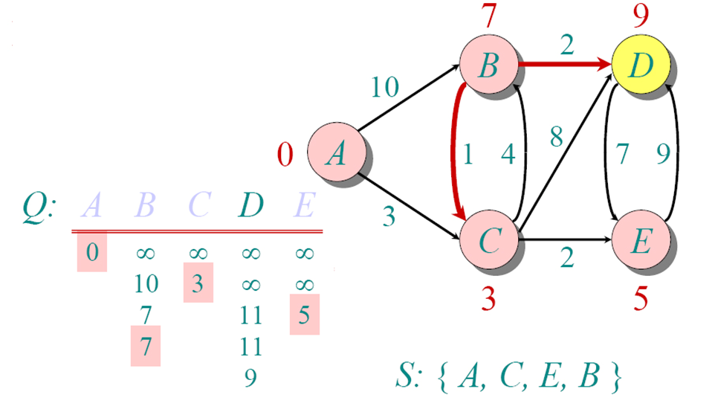

Slide 54
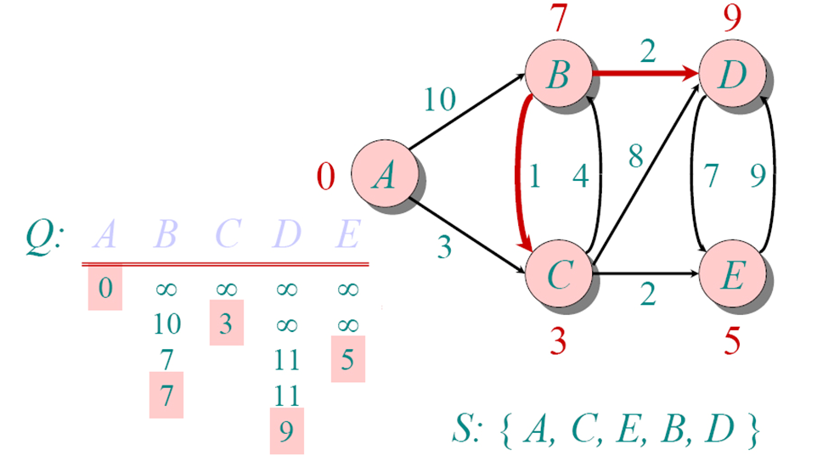

Slide 55
KRUSKAL’S ALGORITHM

Slide 56
It is an algorithm to find the minimum spanning tree.
Its approach is greedy.
Algorithm is simple, find first |V|-1 edges with minimum cost without a cycle.

Slide 57
F
3
C
10
A
4
3
8
4
5
B
6
D
4
4
H
2
1
3
G
E
3

Slide 58
Sort the edges by increasing edge weight
F
3
C
edge | d_{v}
(D,E) | 1
(D,G) | 2
(E,G) | 3
(C,D) | 3
(G,H) | 3
(C,F) | 3
(B,C) | 4
edge | d_{v}
(B,E) | 4
(B,F) | 4
(B,H) | 4
(A,H) | 5
(D,F) | 6
(A,B) | 8
(A,F) | 10
10
A
4
3
8
4
5
B
6
D
4
4
H
2
1
3
G
E
3

Slide 59
Select first |V|–1 edges which do not generate a cycle
F
3
C
edge | d_{v}
(D,E) | 1 | √
(D,G) | 2
(E,G) | 3
(C,D) | 3
(G,H) | 3
(C,F) | 3
(B,C) | 4
edge | d_{v}
(B,E) | 4
(B,F) | 4
(B,H) | 4
(A,H) | 5
(D,F) | 6
(A,B) | 8
(A,F) | 10
10
A
4
3
8
4
5
B
6
D
4
4
H
2
1
3
G
E
3

Slide 60
Select first |V|–1 edges which do not generate a cycle
F
3
C
edge | d_{v}
(D,E) | 1 | √
(D,G) | 2 | √
(E,G) | 3
(C,D) | 3
(G,H) | 3
(C,F) | 3
(B,C) | 4
edge | d_{v}
(B,E) | 4
(B,F) | 4
(B,H) | 4
(A,H) | 5
(D,F) | 6
(A,B) | 8
(A,F) | 10
10
A
4
3
8
4
5
B
6
D
4
4
H
2
1
3
G
E
3

Slide 61
Select first |V|–1 edges which do not generate a cycle
F
3
C
edge | d_{v}
(D,E) | 1 | √
(D,G) | 2 | √
(E,G) | 3 | χ
(C,D) | 3
(G,H) | 3
(C,F) | 3
(B,C) | 4
edge | d_{v}
(B,E) | 4
(B,F) | 4
(B,H) | 4
(A,H) | 5
(D,F) | 6
(A,B) | 8
(A,F) | 10
10
A
4
3
8
4
5
B
6
D
4
4
H
2
1
3
G
E
3
Accepting edge (E,G) would create a cycle

Slide 62
Select first |V|–1 edges which do not generate a cycle
F
3
C
edge | d_{v}
(D,E) | 1 | √
(D,G) | 2 | √
(E,G) | 3 | χ
(C,D) | 3 | √
(G,H) | 3
(C,F) | 3
(B,C) | 4
edge | d_{v}
(B,E) | 4
(B,F) | 4
(B,H) | 4
(A,H) | 5
(D,F) | 6
(A,B) | 8
(A,F) | 10
10
A
4
3
8
4
5
B
6
D
4
4
H
2
1
3
G
E
3

Slide 63
Select first |V|–1 edges which do not generate a cycle
F
3
C
edge | d_{v}
(D,E) | 1 | √
(D,G) | 2 | √
(E,G) | 3 | χ
(C,D) | 3 | √
(G,H) | 3 | √
(C,F) | 3
(B,C) | 4
edge | d_{v}
(B,E) | 4
(B,F) | 4
(B,H) | 4
(A,H) | 5
(D,F) | 6
(A,B) | 8
(A,F) | 10
10
A
4
3
8
4
5
B
6
D
4
4
H
2
1
3
G
E
3

Slide 64
Select first |V|–1 edges which do not generate a cycle
F
3
C
edge | d_{v}
(D,E) | 1 | √
(D,G) | 2 | √
(E,G) | 3 | χ
(C,D) | 3 | √
(G,H) | 3 | √
(C,F) | 3 | √
(B,C) | 4
edge | d_{v}
(B,E) | 4
(B,F) | 4
(B,H) | 4
(A,H) | 5
(D,F) | 6
(A,B) | 8
(A,F) | 10
10
A
4
3
8
4
5
B
6
D
4
4
H
2
1
3
G
E
3

Slide 65
Select first |V|–1 edges which do not generate a cycle
F
3
C
edge | d_{v}
(D,E) | 1 | √
(D,G) | 2 | √
(E,G) | 3 | χ
(C,D) | 3 | √
(G,H) | 3 | √
(C,F) | 3 | √
(B,C) | 4 | √
edge | d_{v}
(B,E) | 4
(B,F) | 4
(B,H) | 4
(A,H) | 5
(D,F) | 6
(A,B) | 8
(A,F) | 10
10
A
4
3
8
4
5
B
6
D
4
4
H
2
1
3
G
E
3

Slide 66
Select first |V|–1 edges which do not generate a cycle
F
3
C
edge | d_{v}
(D,E) | 1 | √
(D,G) | 2 | √
(E,G) | 3 | χ
(C,D) | 3 | √
(G,H) | 3 | √
(C,F) | 3 | √
(B,C) | 4 | √
edge | d_{v}
(B,E) | 4 | χ
(B,F) | 4
(B,H) | 4
(A,H) | 5
(D,F) | 6
(A,B) | 8
(A,F) | 10
10
A
4
3
8
4
5
B
6
D
4
4
H
2
1
3
G
E
3

Slide 67
Select first |V|–1 edges which do not generate a cycle
F
3
C
edge | d_{v}
(D,E) | 1 | √
(D,G) | 2 | √
(E,G) | 3 | χ
(C,D) | 3 | √
(G,H) | 3 | √
(C,F) | 3 | √
(B,C) | 4 | √
edge | d_{v}
(B,E) | 4 | χ
(B,F) | 4 | χ
(B,H) | 4
(A,H) | 5
(D,F) | 6
(A,B) | 8
(A,F) | 10
10
A
4
3
8
4
5
B
6
D
4
4
H
2
1
3
G
E
3

Slide 68
Select first |V|–1 edges which do not generate a cycle
F
3
C
edge | d_{v}
(D,E) | 1 | √
(D,G) | 2 | √
(E,G) | 3 | χ
(C,D) | 3 | √
(G,H) | 3 | √
(C,F) | 3 | √
(B,C) | 4 | √
edge | d_{v}
(B,E) | 4 | χ
(B,F) | 4 | χ
(B,H) | 4 | χ
(A,H) | 5
(D,F) | 6
(A,B) | 8
(A,F) | 10
10
A
4
3
8
4
5
B
6
D
4
4
H
2
1
3
G
E
3

Slide 69
Select first |V|–1 edges which do not generate a cycle
F
3
C
edge | d_{v}
(D,E) | 1 | √
(D,G) | 2 | √
(E,G) | 3 | χ
(C,D) | 3 | √
(G,H) | 3 | √
(C,F) | 3 | √
(B,C) | 4 | √
edge | d_{v}
(B,E) | 4 | χ
(B,F) | 4 | χ
(B,H) | 4 | χ
(A,H) | 5 | √
(D,F) | 6
(A,B) | 8
(A,F) | 10
10
A
4
3
8
4
5
B
6
D
4
4
H
2
1
3
G
E
3

Slide 70
Select first |V|–1 edges which do not generate a cycle
F
3
C
edge | d_{v}
(D,E) | 1 | √
(D,G) | 2 | √
(E,G) | 3 | χ
(C,D) | 3 | √
(G,H) | 3 | √
(C,F) | 3 | √
(B,C) | 4 | √
edge | d_{v}
(B,E) | 4 | χ
(B,F) | 4 | χ
(B,H) | 4 | χ
(A,H) | 5 | √
(D,F) | 6
(A,B) | 8
(A,F) | 10
A
3
4
5
B
D
H
2
1
}
3
G
E
not
considered
Done
Total Cost = Σ d_{v} = 21

Slide 71
You are given an undirected weighted graph and a source point. Weight of the edge is the points you get on traversing that edge. You can traverse an edge multiple times. You need to traverse exactly ‘K’ edges and earn maximum points. Tell how much you can earn?

